Slide 1
3-D Spline
COSC 4364: Zhao Li, Harshesh Shah

Slide 2
Bézier curve
We used Bézier curve to determine the smooth path of the curve (the spline).
Named after Pierre Bézier, who used it in the 1960s, is now particularly used in animation, user interface design and smoothing cursor trajectory.

Slide 3
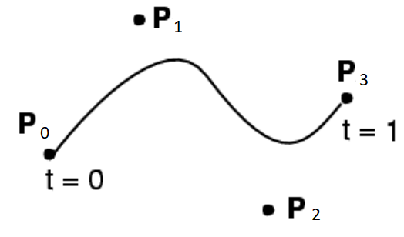
Bézier curve ...Cont’d
• User specifies 4 control points P0 ... P3
• Curve goes through (interpolates) the ends P0, P3
• Approximates the two other ones
• Cubic polynomial

Slide 4
Algorithms
Linear, quadratic, cubic Bézier implemented
Default is cubic Bézier, with 50 samples between each points
To create actual curve, points are split depending on which type of Bézier
Linear: B(t) = (1 - t)P0 + tP1
Quadratic: B(t) = ((1 - t)^2 * P0) + (2(1 - t)tP1) + (t^2 * P2)
Cubic: B(t) = ((1 - t)^3 * P0) + (3(1 - t)^2 * tP1) + (3(1 - t) t^2 * P2) + t^3 * P3
0<= t <=1 for all

Slide 5
Code Organization
Graphical user interface in main.py
Bézier calculations are in BézierCurve.py
In BézierCurve.py, options available
Type of Bézier Curve
Sampling points

Slide 6
Input/Output
2 input files:
GCorridor.csv
smooth_path.csv
Output are the interpolated coordinates (x, y, z)
GUI output is:
Actual values, spline, spline with radius
Could also uncomment plt.show() on line 203 in BezierCurve.py

Slide 7
GUI
Used Tkinter to represent the input, and the spline on the window.
Created Canvas to implement the graphs.
Used Tkinter widget libraries to put the matplotlib graphs on the same window.

Slide 8
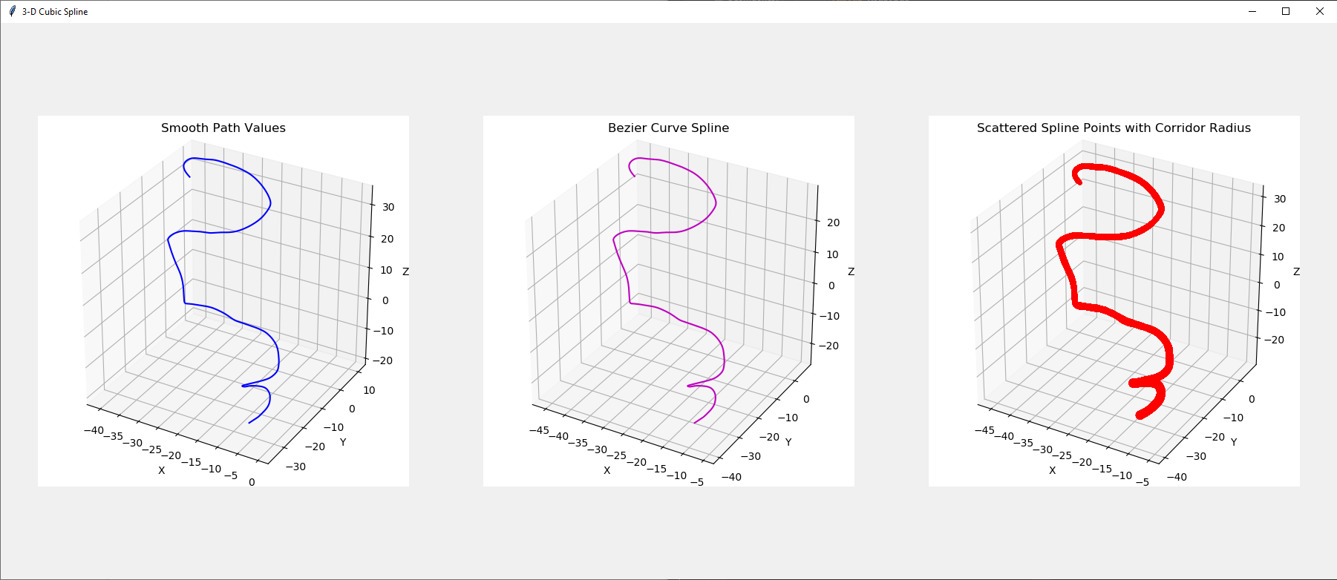
GUI Output

Slide 9
Performance
Using Python’s time library
Sample points vs time using Cubic Bézier:
10 points, 31 milliseconds
50 points, 150 ms
100 points, 301 ms
1000 points, 3045 ms
Linear points vs time

Slide 10
References
Our Github Repo: https://github.com/frankzhaoli/COSC4364FinalProject/tree/master
https://en.wikipedia.org/wiki/B%C3%A9zier_curve
http://web.mit.edu/hyperbook/Patrikalakis-Maekawa-Cho/node12.html

